Slide 1
CHAPTER 4
TABLE

Slide 2

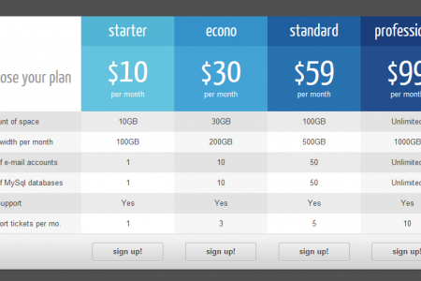
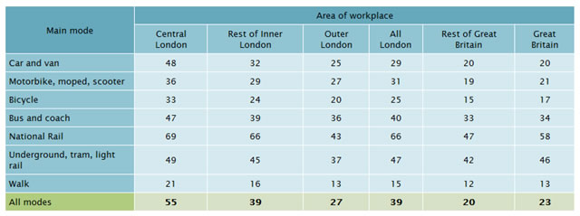
OBJECTIVES FOR TODAY
Define the TABLE STRUCTURE:
TABLE TAGS
TABLE STYLE

Slide 3
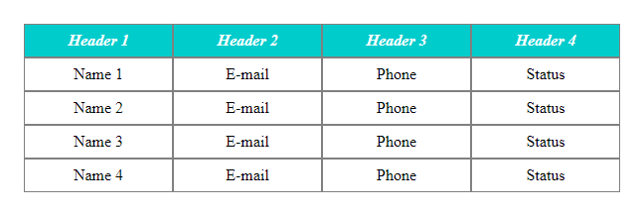
QUIZ
How many rows of this table below?
1
2
3
4
4 rows
5 rows
6 rows
20 rows

Slide 4
QUIZ
How many rows of this table below?
1
2
3
4
4 rows
5 rows
6 rows
20 rows

Slide 5
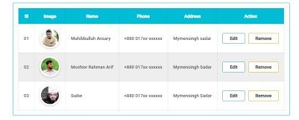
QUIZ
How many columns of this table below?
1
2
3
4
4 columns
5 columns
6 columns
24 columns

Slide 6
QUIZ
How many columns of this table below?
1
2
3
4
4 columns
5 columns
6 columns
24 columns

Slide 7
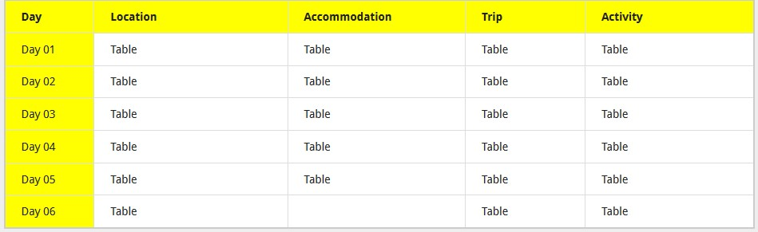
QUIZ
How many cells of this table below?
1
2
3
4
7 cells
5 cells
28 cells
35 cells

Slide 8
QUIZ
How many cells of this table below?
1
2
3
4
7 cells
5 cells
28 cells
35 cells

Slide 9


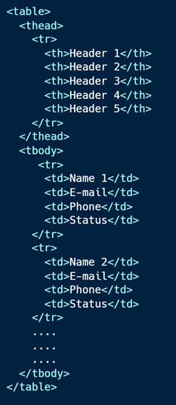
EXPLAIN
Table structure is defined in the HTML
5 MIN
CLASS

Slide 10
EXPLAIN
Table tags meaning
5 MIN
CLASS
TAG | DESCRIPTION
<table> | Defines a table
<thead> | Groups the header content in a table
<tbody> | Groups the body content in a table
<tr> | Defines a row in a table
<th> | Defines a header cell in a table (Default text in <th> is center)
<td> | Defines a cell in a table
<caption> | Defines a table caption
Notes:
https://www.w3schools.com/html/html_tables.asp

Slide 11
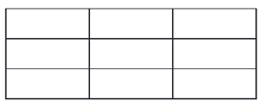
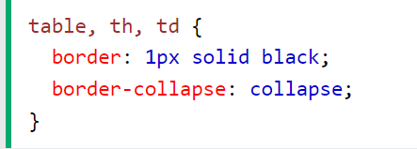
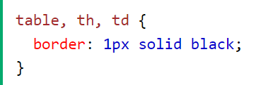
QUIZ
Table borders
5 MIN
CLASS
How to obtain this result ?
1
2
1
Notes:
https://www.w3schools.com/html/html_tables.asp

Slide 12
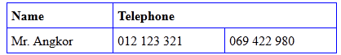
EXPLAIN
Column span
5 MIN
CLASS
<table style="width:30%">
<tr>
<th>Name</th>
<th colspan="2">Telephone</th>
</tr>
<tr>
<td>Mr. Angkor</td>
<td>012 123 321</td>
<td>069 422 980</td>
</tr>
</table>
Notes:
https://www.w3schools.com/html/html_tables.asp

Slide 13
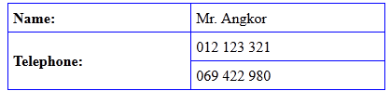
EXPLAIN
Row span
5 MIN
CLASS
<table style="width:30%">
<tr>
<th>Name:</th>
<td>Mr. Angkor</td>
</tr>
<tr>
<th rowspan="2">Telephone:</th>
<td>012 123 321</td>
</tr>
<tr>
<td>069 422 980</td>
</tr>
</table>
Notes:
https://www.w3schools.com/html/html_tables.asp

Slide 14

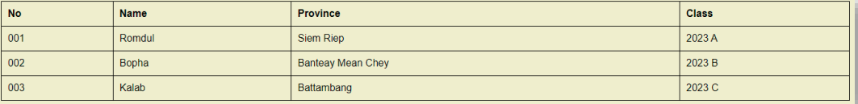
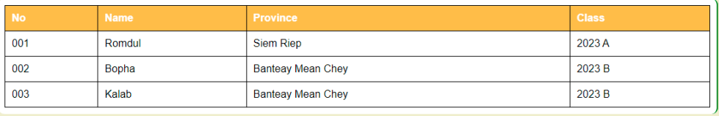
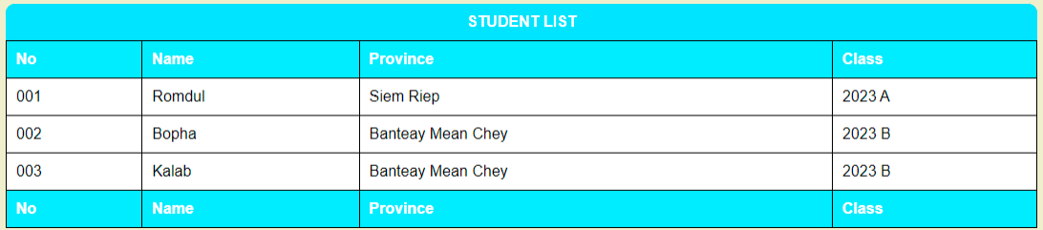
ACTIVITY
Activity 1
From start code, style the table as follows :
15 MIN
INDIV
V1
V2
V3
Notes:
https://www.w3schools.com/html/html_tables.asp

Slide 15
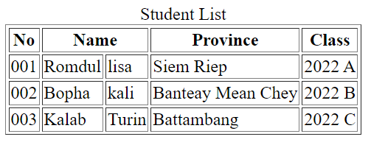
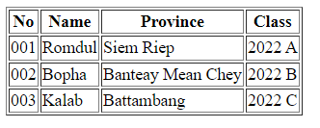
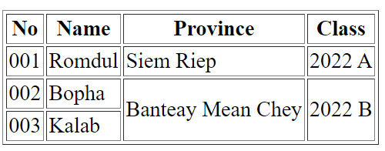
ACTIVITY
Activity 2
15 MIN
INDIV
Change the HTML to merge some row or columns :
INITIAL
V1
V2
Notes:
https://www.w3schools.com/html/html_tables.asp

Slide 16


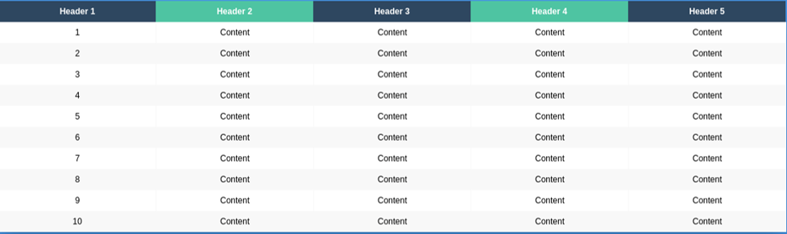
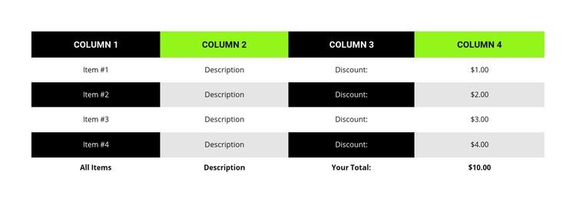
HOMEWORK
Homework
Create the following 2 tables
INDIV
Table 1
Table 2

